Slide 1

FINANCIAL LESSONS FROM A MOTHER
Notes:
Today’s presentation is on Financial lessons from a mother. It is quite natural to think of the fact that a mother is the first teacher of a child. The child grows up in her light and inculcates her habits and essences in him. At times oblivious of the fact she passes on her financial planning strategies as well. Today we will be discussing how a child learns his initial financial lessons from the mother.

Slide 2

TAKE RISKS
Notes:
A child’s first steps are very special to his mother, some of us capture those magical moments in photographs, and some of us record it in videos. Amid all this excitement the mother is also afraid that the child might falter and hurt himself but she braces herself since the risk has to be taken or the child might not be a late bloomer or worse still inhibit his growth. She makes sure that she will be there to hold him if he falls, but she takes the necessary risk nevertheless and edges him on. This should be the stepping stone in our life of financial investment. We have to take risks to grow. No success is a path of roses and has to be hard earned through taking risks.

Slide 3
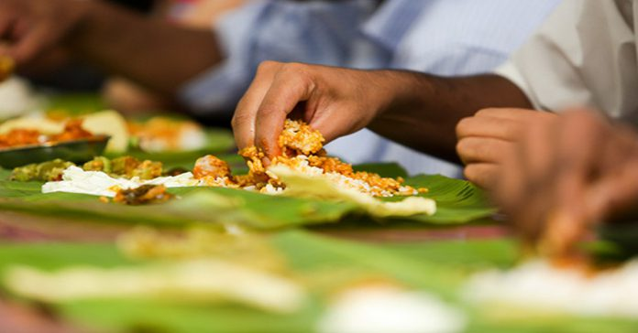
HOW TO EAT HOT FOOD
Notes:
The second lesson that a mother teaches her child is how to feed him. We need food to grow; likewise we need workforce and resources to grow financially. I recall Chanakya’s story, wherein after several unsuccessful attempts at bringing down Dhana Nanda he was unable to understand why he had failed every single time despite his hardest attempts. Then one fine day he was passing through a small hut when he noticed that a child was crying bitterly because he had burnt his hand trying to eat hot khichdi right from the centre where it was hottest. Chanakya listened in rapt attention when the mother taught the child that start from the edges where it is cooler, slowing but steadily digging into the centre. Something in Chanakya’s mind clicked and he understood why his strategy had failed every time attacking the centre, then he gathered small forces steadily and soon grew into a large army and tumbled down Dhana Nanda. This should be every investor’s strategy, start small, and grow big. We each of us have big goals, but they cannot be attained just like that. Like Chanakya we have to focus on each small goal to achieve the bigger goal.

Slide 4

DON’T LEAVE IT ON TOMORROW, PREPARE TODAY (INVEST TODAY)
Notes:
We all surely remember that when we were in school and were given something like projects, or homework to do, we all wanted to stack it away and start tomorrow. And our mothers came down hard upon us and made us do the work then and there. That is another important lesson in our life. We cannot leave it to tomorrow because tomorrow never comes. 10 years down the lane we will be regretting, wishing we had started now. Investments however small it is, however difficult it is, it has to be started now. What really matters is the beginning of the effort we put in and the rest will follow.

Slide 5
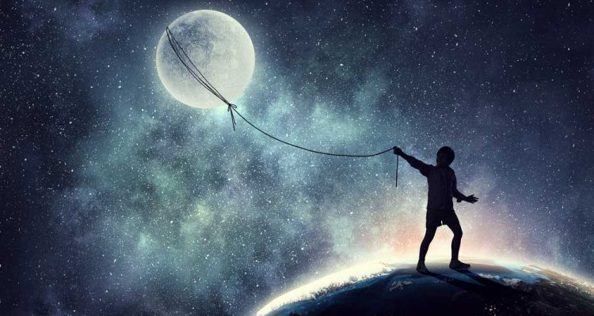
LAW OF ATTRACTION
Notes:
We have often heard people saying that their wavelengths match with certain people. We all vibrate at certain frequencies and people whose frequencies match with us, share the same wavelength with us while others are distant towards us. Now being a financial advisor it is very important for us that we be able to associate with a varied lot of people. We thereby have to broaden our horizons as well as our frequencies to incorporate as many people as possible and at the same time make them feel at home around us. Or else our clients might feel alienated and we might lose their confidence. To demonstrate this theory I would kindly ask for two volunteers to come up and would also request a bottle of perfume. Now when we rub on the perfume on our hand and rub the same hand on the next person, that person also retains an essence of the perfume. In a similar way the mother also passes on her essence onto her child, therefore she must be aware of what qualities she is passing on to the child. Positive qualities breed positive results while negative qualities will definitely bring down one’s abilities.

Slide 6

WEALTH IS ENERGY OF FEMININITY
Notes:
Mother is often associated with Mother Earth. Femininity is connected to emotions, creativity and loving nature. When these qualities are absorbed into our work of creating wealth the chances of our investment bloom increases. Whatever wealth an investor or advisor is earning, if he manages to channel his wealth towards the goal of helping and reaching out to others, there is a higher probability that this wealth will find it’s way back to him manifold. This is therefore a very important lesson that we should channel our wealth in the productive good of mankind, just like our mothers had always channeled their productive good and their efforts towards us for our good and those qualities do reflect in us throughout our lifetime.

Slide 7

LIFE OF A MOTHER
Notes:
Let’s observe a day in the life of a mother. She wakes up early in the morning at the sound of her alarm and brushes her teeth and probably her kid’s teeth as well. Right there Colgate or Pepsodent makes money out of it. When she is taking a phone call, Airtel makes money out of it. She has her breakfast Britannia makes money out of it. Then she takes a car to the office, Maruti or probably Ashok Leyland makes money out of it. When she reaches her office there is an internet solution, probably Infosys or Tech Mahindra makes money out of it. After that at 11 o’clock maybe she receives an sms regarding a salary or incentive some bank like ICICI makes money out of it. Then maybe she sends her employee to some client, the employee uses a bike like Hero or Honda, they make money out of it and it goes on. When she goes back home and has her dinner, ITC has made money out of it. So the bottom line is there is a lot of consumption throughout the day. The point I am driving at is if we can turn these consumptions to source of our income. They can become a part of our portfolio. Friends what I trying to say is about mutual fund portfolio. This is a portfolio of all the stocks , of all the companies which a mother, a child is consuming throughout the day. Same way, all this consumption looks like an expense, but if all these stocks are a part of a mutual fund portfolio; then you can actually feel happy about nibbling the biscuit since you are as well making money out of it. This way we can compare the life of a mother to that of an investor.

Slide 8

Notes:
St. Francis of Assisi says that it is in giving that we receive. Let’s do a small exercise. Let’s all inhale and exhale deeply, ask the audience whether their belly is in or out. Half of the audience might say that their belly has been going in while exhaling or vice versa. Now ask the audience to keep on inhaling continuously, as a result they get stuck at point. Now ask them why can’t they continuously inhale, some might say that it is not possible to continuously take in air without giving out. That’s the exact same procedure with investments. We cannot expect that our wealth will keep on growing, their bank balance will keep on grow. But it will not grow until you have given it to someone, no holistic growth will take place. This attitude of giving is what we can learn from our mothers. Mothers keep on giving us her time, resources, love, kindness and so much more and in return she receives a dutiful and strong child that she raises. So, unless you give you cannot get.

Slide 9

SPEND LESS THAN
WHAT YOU GET-
PIGGY BANK
Notes:
Mothers have been our first financial advisor. She had inculcated in us the concept of saving and had got our first piggy bank for us. The mantra to growing our wealth is spending less than we earn. That is the path to our financial freedom. However it is our parents who actually help us move on with our goals from the very beginning of our lives by instilling in us the habit of saving.

Slide 10
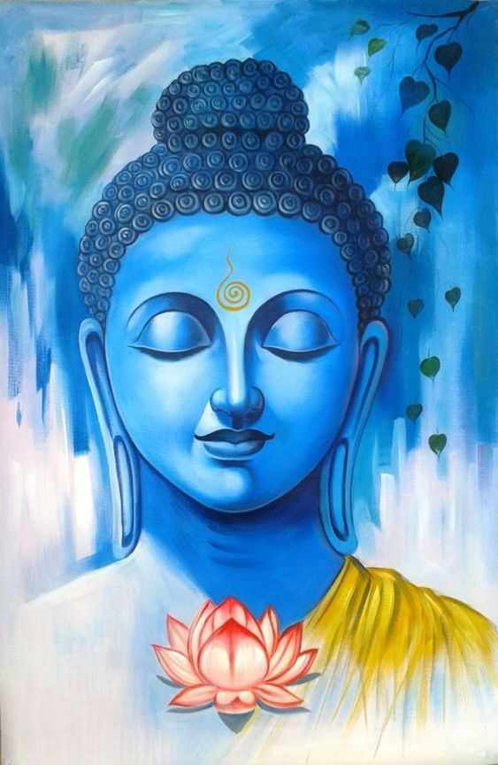
DON’T BE
MATERIALISTIC, FIRST SAVE THEN BUY.
POSTPONEMENT OF INSTANT GRATIFICATION
Notes:
Nothing in this world comes instantly other than those instant coffees. To grow something solid and of quality we need time and perseverance. Most of our mothers have been ingraining in our minds that only hard work and time pays off. Lets’ think of an example, suppose someone has planted a sapling and expects mangoes right out of it. What he receives instead is despair. Give the sapling time and right care, it will deliver quality mangoes. Instant gratifications don’t last long so, hold tight and persevere.

Slide 11
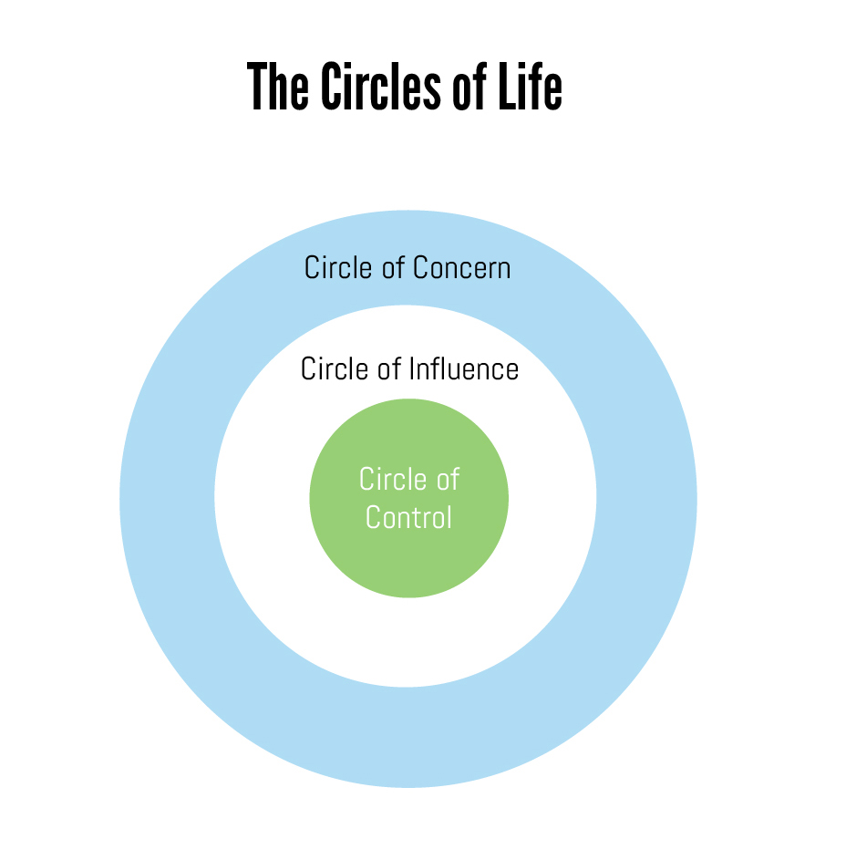
Notes:
The next slide is on stressing on the fact that there are things in our life on which we have control and things on which we don’t have our control. The mother is concerned about all things that might or might not go wrong with her child. This is where we should learn a lesson. We should be concerned with what we can influence and work on rather than which is beyond our control. So it is with us investors, when we have a team, we have a date; we have a strategy we should stick to that. Untimely poking up our portfolios might actually depress us and effect our investment instead of lifting our spirits because market keeps going up and down. Therefore it is always advisable to give your investment due time and wait rather than worrying about what calamities might befall us.

Slide 12

STUDENT LIFE IS OF ACHIEVER- HANDEL PRESSURE
Notes:
We learn how to handle pressure just be looking at our mother. She has handled the housework and just swiftly her office work. Yes, many a time she is stressed, she is bogged up, she is anxious, she is angry but she has come out of it beautifully. This is something we all need to learn. These situations will come in our lives as well, we might run broke, we might have credit card dues, but we will need faith and strength to hold our heads high and gracefully maintain the discipline and continue to keep aside the money he have kept for some investment, whatever the situation is.

Slide 13

Notes:
These life lessons will keep our goal planning and wealth management in track. If all of them are followed precisely or step by step, life will be full of abundance. As St. Francis of Assisi says that it is in giving that we receive. If we want mangoes than we should plant mango trees and not guava trees

